Slide 1
Client Meeting
Dr. Robyn Choi
Dr. Chris Gonzalez
3rd August 2022

Slide 2
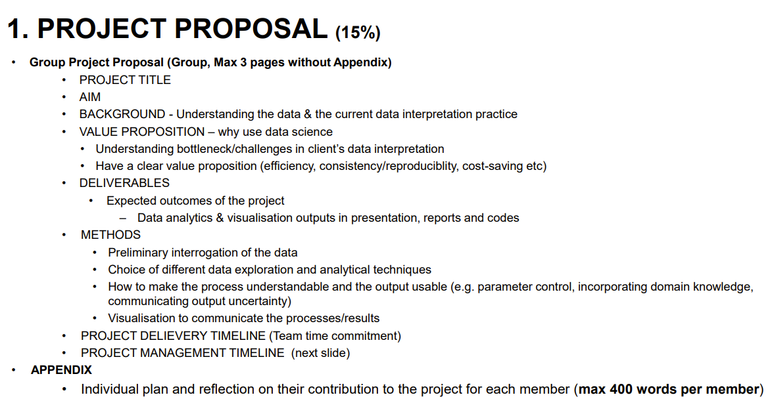


Slide 3
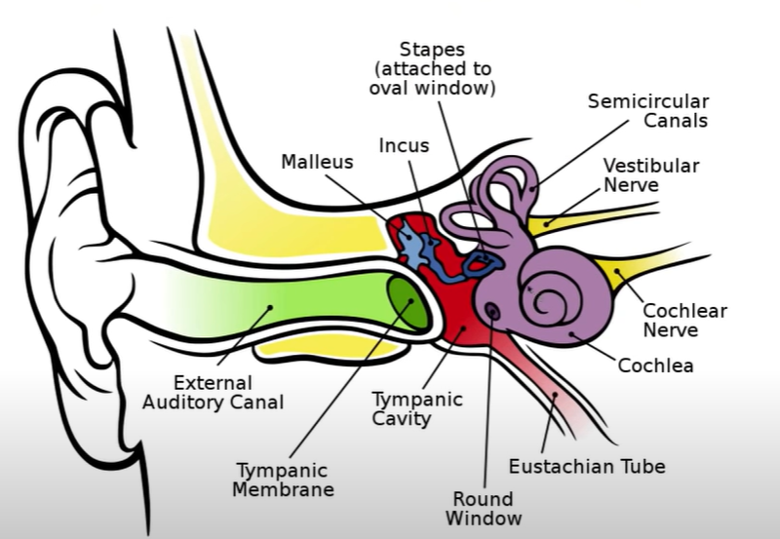
EAR 101

Slide 4
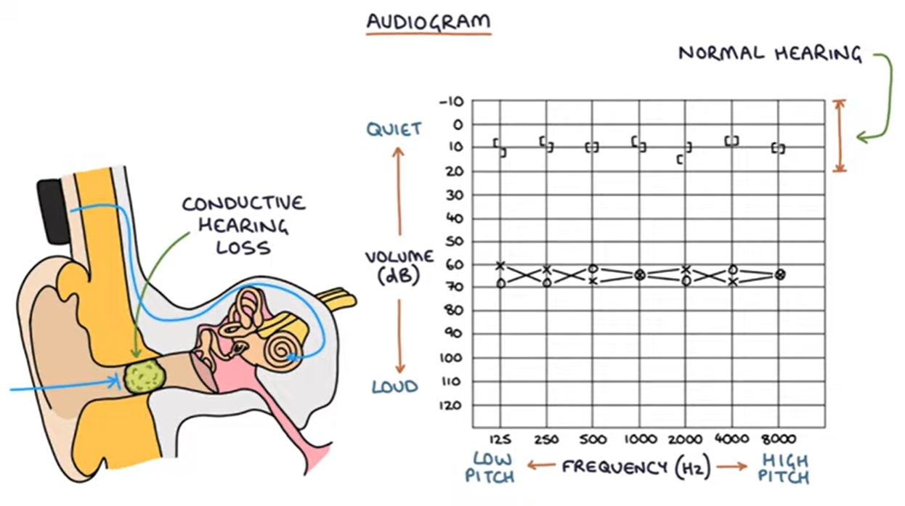
Audiogram 101

Slide 5
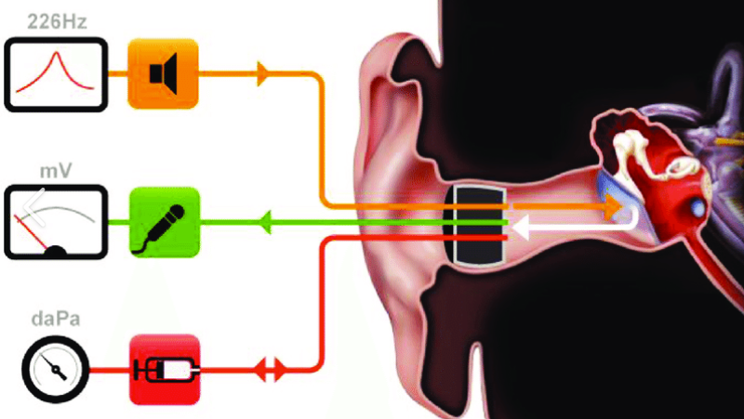
Tympanometry

Slide 6
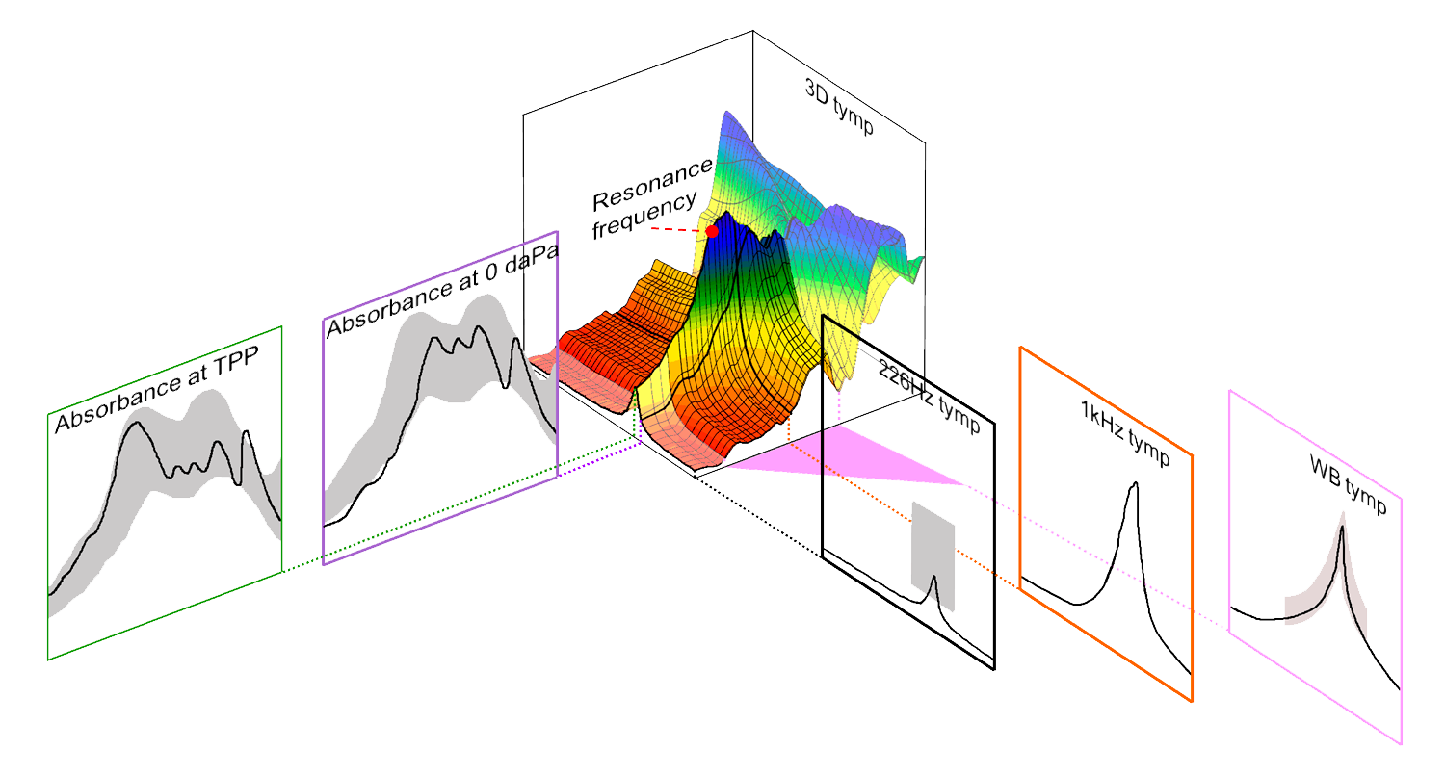
WBA and WBT

Slide 7
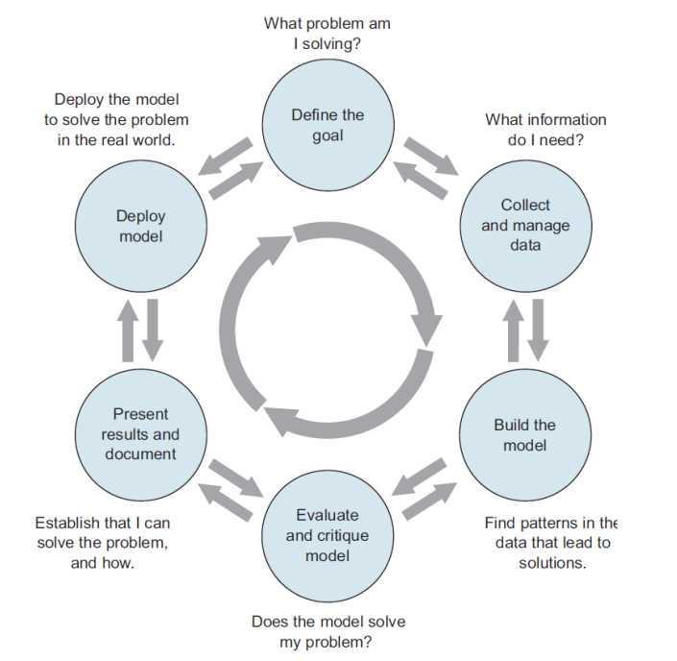
Data Science Cycle

Slide 8
Project Objective
Deliverables
To detect and understand which frequency regions in WBA and WBT results are most useful for detecting conductive conditions in children;
To investigate whether machine learning tools is more accurate at detecting ears with conductive condition compared to receiver operating characteristics analysis.
?

Slide 9
Questions from the Team
Could we get an explanation of the data in laymen’s term
Are we able to add external data to this investigation?
What is the current procedure of classifying irregularities in typical conductive ears?
What measures are typically more important for determining conductive hearing loss. Absorbance? Pure Tone Audiometry?
What factors are typically significant or correlate with chances of conductive hearing loss i.e does age really matter if we are looking at children? Does Naplan score really matter?
Does size ratio of tympanic membrane to the elliptical window significantly affect the middle ear conductive efficiency?
Is there labelled data for each subject number showing weather the subject has conductive hearing conditions
How is receiver operating characteristics used to detect ears with conductive conditions

Slide 10
Next steps
Conduct exploratory data analysis
1
Develop a research proposal
2
Complete a project delivery timeline
3
Complete a project management schedule
4

Slide 11
Housekeeping
Discuss and agree on schedule for progress meeting
Actions to take are for:
Team –
Client –

